Slide 1
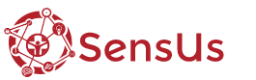


Microfluidic impedance biosensor
BarcelonaTech
SensUs 2018

Slide 2
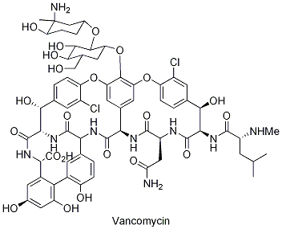
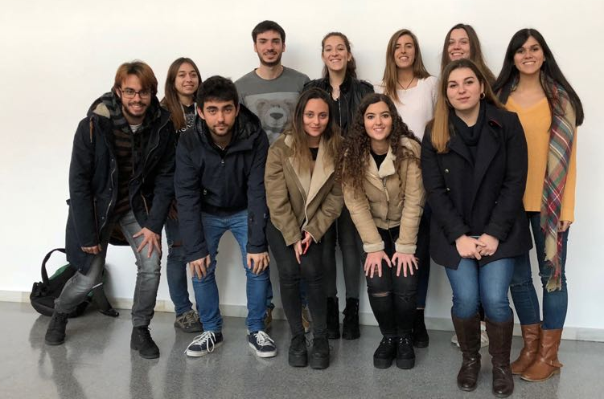
The team for one purpose

Slide 3

Concept formulation
LITERATURE RESEARCH
A systematic Review of Vancomicyn dosing and monitoring in burn patients Breanna L. Carter, PharmD, BCPS,*† Kendra M. Damer, PharmD,*† Todd A. Walroth, PharmD, BCPS,*‡║ Natalie R. Buening, PharmD, BCPS,* David R. Foster, PharmD, FCCP,*‡ Rajiv Sood, MD, FACS§║
Integrated hollow microneedleoptofluidic biosensor for therapeutic drug monitoring in sub-nanoliter volumes. Sahan A. Ranamukhaarachchi1,2,3, Celestino Padeste3, Matthias Dübner3, Urs O. Häfeli2,Boris Stoeber1,4 & Victor J. Cadarso3 Therapeutic drug monitoring (TDM) typically Published: 06 July 2016
Applying Pharmacokinetic/Pharmacodynamic: Principles in Critically Ill Patients: Optimizing. Efficacy and Reducing Resistance Development
Mohd H. Abdul-Aziz, BPharm1 Jeffrey Lipman,MD1,2 JohanW.Mouton, PhD3,4 WilliamW. Hope, PhD5 Jason A. Roberts, PhD1,2,5

Slide 4

Concept formulation
Great reduction of costs and of sanitary employees
Reduction of laboratories.
It is expected that by 2050 resistance to antibiotics will be the leading cause of death, so it is necessary to find biosensors that detect the optimal amount off dose to be administered.
Personalized medicine is the goal.
Microfluidic design with 3D printing
Sensor: gold electrode
Electronic design
Implementation of the ELISA method on a chip

Slide 5
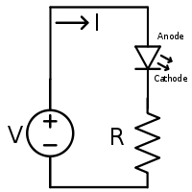
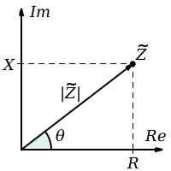
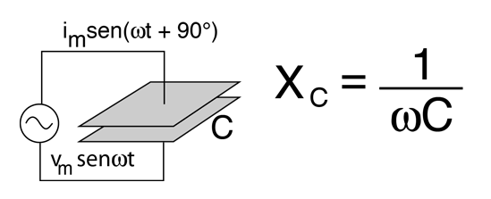
Impedance biosensor
.
Detection of Vancomycin
Conductance variation between the medium and the electrode
Impedance changes
Obtained magnitude reaction process
Complex number Z = R + Xj
Opposition to the passage of the current
Resistance + Reactance
Record of biochemical reactions that occur on the surface of chemically modified electrodes.
Immobilization of molecules

Slide 6


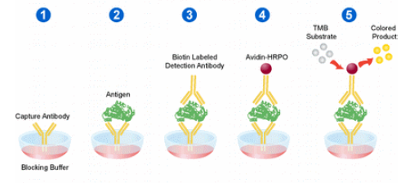
Elisa on a chip
Primary Antibody
Second Antibody +HRP
Wash solution
Reaction solution
Vancomycin

Slide 7
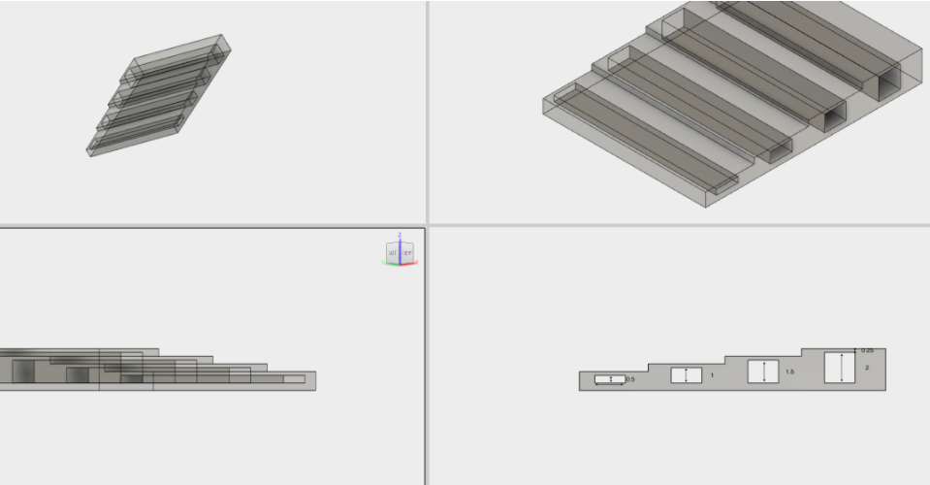
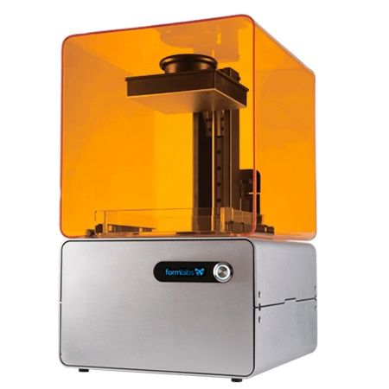
Preliminary design
3D printing: Stereolithography
Fusion360

Slide 8
Evaluation
Formulating the design question- done
Literature research- done
Concept formulation- done
Preliminary design- done
Detailing- not started yet
Realization- not started yet
Testing- not started yet
Evaluation- in progress

